Slide 1
F.I.T.
Austin HIGH SCHOOL
Student Instructional Video
Notes:
This is the student instructional video for advisory and FIT sessions for Austin High School. After viewing this presentation, you should have a good idea of what to expect from these programs this year.

Slide 2
FIT is Tuesday-Friday after 1st/ 5th periods
Weekly schedule for advisory/FIT:
Monday: Advisory
Tuesday: F.I.T.
Wednesday: F.I.T.
Thursday: F.I.T.
Friday: F.I.T.
Notes:
Homeroom and FIT sessions will occur after the first period of the day on all regular school days from 10:35-11:00 am. Advisory and FIT will not meet on late starts, pep rally days, or testing days. The basic schedule for the week is Advisory on Mondays and FIT on Tuesdays, Wednesdays, Thursdays and Fridays.

Slide 3

So, what is FIT?
Notes:
First, let’s look at FIT.

Slide 4

F.I.T.
F.I.T. stands for Flexible Instructional Time. F.I.T. sessions are designed by the individual teacher to support student learning outside of the normal class instructional time but inside the school day. FIT sessions will occur on Tuesdays, Wednesdays, Thursday, and Fridays.
Examples of meetings that teachers may offer:
Re-teach
Make-up work
Content review
Test prep (EOC, AP, SAT, etc.)
Guided study
Extension activities
Notes:
FIT stands for Flexible Instructional Time. FIT sessions are designed by the individual teacher to support student learning outside of the normal class instructional time but inside the school day. FIT is a time for you to personalize your academic day and it gives you time to take care of things you might otherwise have to come in or early or stay after school to complete. You can choose to use this time to get organized, complete homework assignments, meet with teachers for tutorials, make up missed assignments, and even explore subjects you’d like to learn more about. FIT is also a time for teachers to assign you to a session if they feel you need extra help, additional time, or for some other reason. If a teacher assigns you to a session, it doesn’t mean you are in trouble or have done something wrong, but you are required to attend. You will not be able to schedule yourself for any other session that day.

Slide 5
Why F.I.T.?
There are a lot of great benefits to our F.I.T. program that you will begin to recognize and enjoy after Labor Day. By having this time during the school day, you will be able to seek help from teachers, make up missing work, collaborate with your peers on a project, study for an upcoming test, etc. If you rely on school bus transportation or are involved in extra curriculars before or after school, it can be tough to take care of these types of things outside of school. F.I.T. allows you the flexibility to take care of your business during the school day.
Notes:
Why FIT? There are a lot of great benefits to our F.I.T. program that you will begin to recognize and enjoy next week. By having this time during the school day, you will be able to seek help from teachers, make up missing work, collaborate with your peers on a project, study for an upcoming test, etc. If you rely on school bus transportation or are involved in extra curriculars before or after school, it can be tough to take care of these types of things outside of school. F.I.T. allows you the flexibility to take care of your business during the school day.

Slide 6
Basic FIT Rules
Sign up for all of your FIT sessions for the week in the FIT Student Portal each Monday. Your teachers may give you time to do this during Advisory on Monday. If not, then do this before school, during lunch, or afer school .
Go where you are supposed to go and stay there.
  no restroom passes
  no library passes
  no locker trips
  no students in the halls, main office, counseling center
Notes:
The rules are pretty simple. Check your FIT portal every Monday after 9:00 am. If you have not been assigned to a session by a teacher, you must sign up for an open session. On FIT days, go where you are supposed to be and stay there. You won’t be able to see a teacher last minute, run to the library, or grab something from your locker, so plan in advance and come prepared.

Slide 7

Basic FIT Rules
Normal class rules apply during FIT time.
Electronic devices must remain out of sight unless the teacher has given you permission to access your device for a valid educational purpose.
Notes:
FIT time is just like class time and everything your teacher expects of you during class will still apply. Keep your electronic devices out of sight unless your teacher has given you permission to access your device for a valid educational purpose.

Slide 8
What happens if I don’t sign up for a session?
If you did not sign up for a session and have no where to go for FIT we will be escorting you to the FIT PIT in classroom #115
Students in the FIT PIT will be assigned a lunch detention for not signing up/attending a FIT session. In the FIT PIT you will be given a slip of paper with your assigned day of lunch detention.
Lunch DETENTION is in the “Maroon Room”. It starts promptly at 12:45 and will last until 1:05. You will have time to grab food after you are released from lunch detention. If you show up tardy to lunch detention you won’t be allowed to attend that day and you will be given 2 days lunch detention.
Notes:
If you are out sick on Monday, you should still sign up for your FIT sessions from home. If you don’t sign up for FIT, you will be taken to the FIT PIT in room 115. Teachers and assistant principals in the FIT PIT will make sure you are signed up for any other sessions left that week and assign you to a lunch detention. In the FIT PIT you will be given a slip of paper with your assigned day of lunch detention. Lunch DETENTION is in the “Maroon Room”. It starts promptly at 12:45 and will last until 1:05. You will have time to grab food after you are released from lunch detention. If you show up tardy to lunch detention you won’t be allowed to attend that day and you will be given 2 days lunch detention.

Slide 9

What happens if I don’t go?
Students who are tardy or skip FIT will be assigned to a
lunch detention on the first offense.
Notes:
If you skip FIT, there will be consequences. If you’re still in the hall when the bell rings for FIT, you will be taken to the FIT PIT in room 115 where you will be assigned lunch detention and sit in silence for the rest of the FIT period. Don’t let this happen to you! Know where you’re going and get there quickly! If you miss a session assigned by your teacher, the FIT portal will automatically send a referral to an AP who will assign you detention.

Slide 10
Advisory
Students have an assigned advisory teacher and will attend
Advisory on Mondays. Attendance will be taken.
Mondays – Every Monday will alternate between a Social Emotional Lesson and Academic advising.
Notes:
You have an assigned advisory class you will attend once a week. Advisory will always occur on Monday but sometimes on Tuesday when Monday is a student holiday.

Slide 11

Introduction to the Student FIT Portal
Notes:
So now let’s look at the Student FIT Portal. This is the system we will use to manage your FIT sessions.

Slide 12



How do I schedule a FIT session?
You will need a computer or smart phone with internet access.
Notes:
Now you will see how simple it is to use your smart phone or a computer to schedule a meeting. Sessions will soon be posted so you can schedule your FIT sessions for next week. Teachers are required to have their FIT sessions posted each Friday for the following week. You may schedule your FIT meetings at any time, but you must check your portal on Monday after 9:00 am to see if a teacher has assigned you to a session.
All sessions are limited to a specified number of seats. Once those seats are scheduled, you will not be able to sign up for that meeting. The earlier you schedule a FIT session, the better your chances are of getting into the one you want!

Slide 13
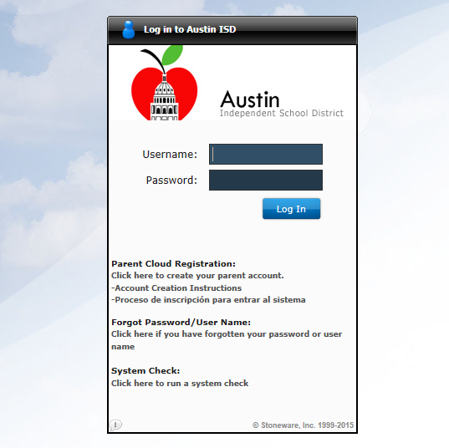
Log in to the AISD Cloud
Type “my.austinisd.org” in your browser bar
Type in your AISD credentials
Notes:
To log into the AISD Cloud to access the student portal, you will first type “my.austinisd.org” into your browser bar.

Slide 14
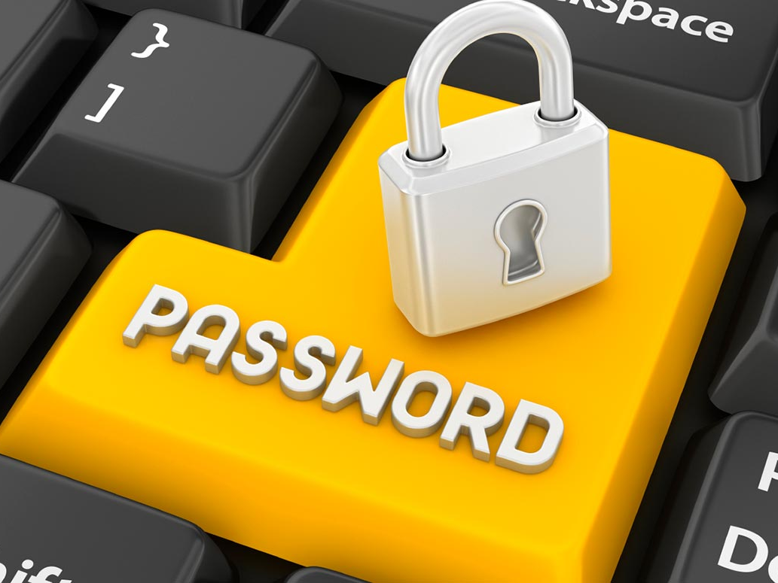
Your Credentials
Capital S
Student Number
Username: S1234567
Password: R073197s
Lower-case “s”
Capitalized
first letter of
your last name
6 digit birth date
Notes:
If you are new to AISD or just don’t remember how to log in, here is how you do it: Your user name will be the capital letter S and then your student number. Your default password is the capital of the first letter of your last name, your six digit birth date and then a lowercase s
If you have changed your password and have forgotten what it is, it will need to be reset. Your teacher can reset it by calling the help desk.

Slide 15
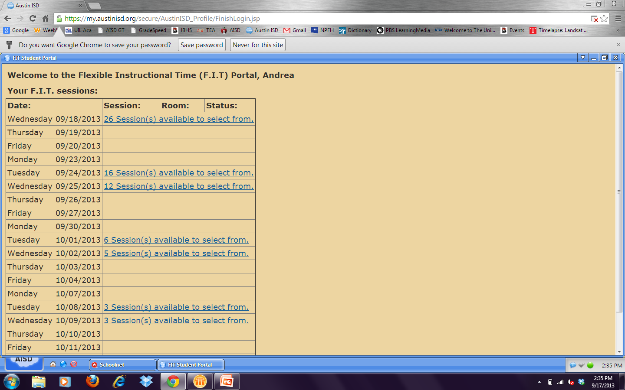
Now your FIT Portal will appear
Click on the date of the next FIT session
Click on the blue link to see a list of the open meetings on that date.
Notes:
Sessions are listed by date. Click on the blue link to see the sessions offered on each day

Slide 16
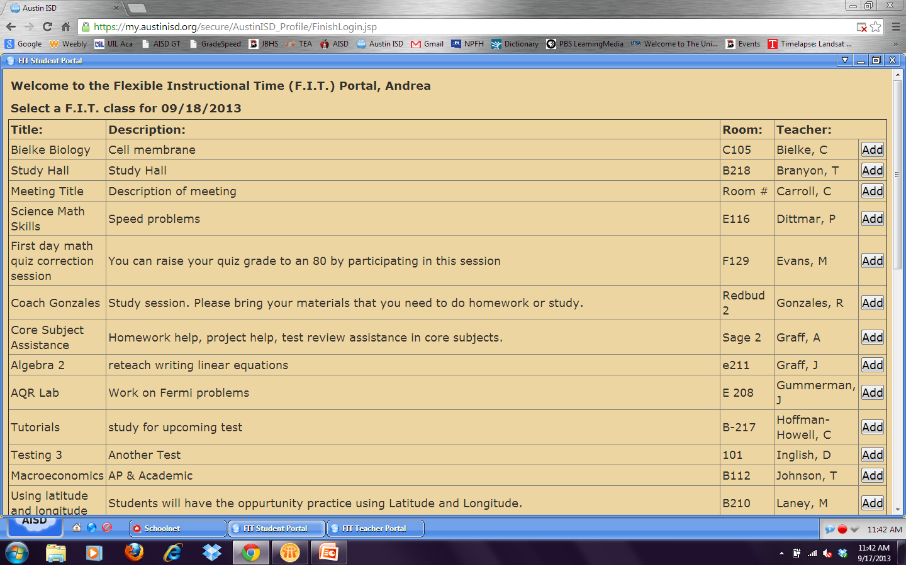
Schedule a meeting by clicking “Add”
Notes:
Click the “add” button to schedule the session you have selected. It’s that easy!

Slide 17
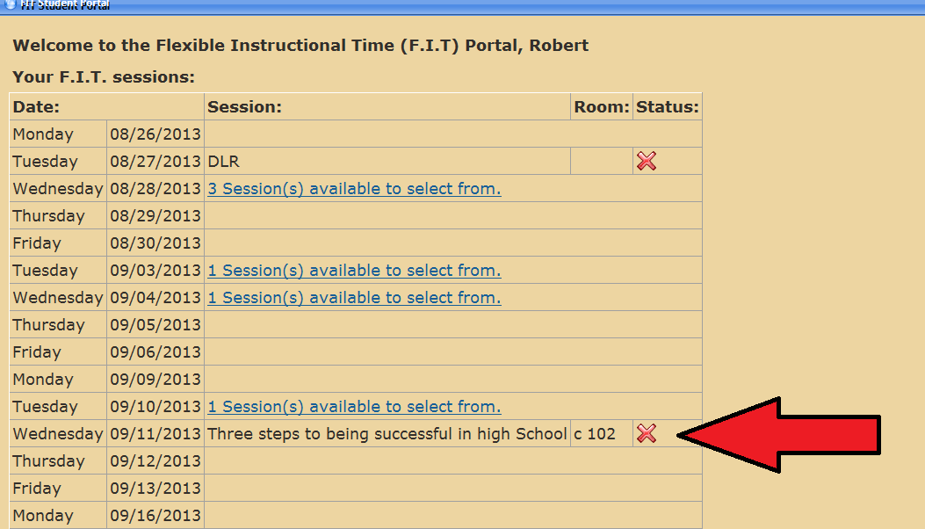
Notes:
After you click “add” it will take you back to the front page of your FIT portal where you will see a list of FIT meetings you have scheduled.

Slide 18
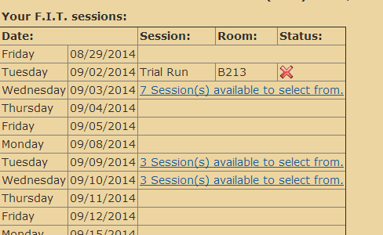
If you need to change, simply click the X to remove yourself. You will get the list of options back if you remove yourself from a session.
Notes:
If you want to change your selection, just click the red X and you will get the blue link back for that day. You can only be scheduled into one session each day, and if a teacher has scheduled that session with you, you cannot change it.

Slide 19
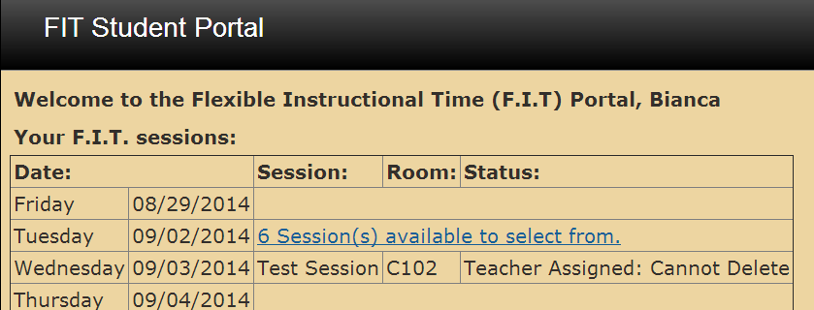
“Teacher Assigned: Cannot Delete” means that you must attend that session assigned by that teacher
Notes:
If you see “Teacher Assigned: Cannot Delete” under “status,” it means that a teacher has assigned you to a FIT session. You may not remove this session. You must attend this session.

Slide 20
Frequently Asked Questions (FAQs)
When do I sign up?
  All sessions will be posted by your teachers on Friday. You may sign up over the weekend or on Monday.
Can more than one teacher assign me at a time?
  No, the system only allows one session per day
What if I forget to sign up?
  You must sign up . If you do not sign up, you will be placed in the FIT PIT (room 115) In room 115 there will be staff members that will make sure you sign up for the FIT sessions for the rest of the week and you will be assigned to lunch detention and sit in silence for the rest of the FIT period.
What if the session I want is full?
  Find another session
Notes:
Here are some frequently asked questions
When do I sign up? All sessions will be posted by your teachers on Friday after 5:00pm. You may sign up over the weekend or on Monday. You will might also have time to sign up during your Monday advisory.
Can more than one teacher assign me at a time? No, the system only allows one FIT session per day.
What if I forget to sign up? If you do not sign up, you will be placed in the FIT PIT (room 115) where you will be assigned to lunch detention and and sit in silence for the rest of the FIT period.
What if the meeting I want is full? Find another session

Slide 21
Frequently Asked Questions (FAQs)
I don’t have a smart phone. How can I sign up for a session?
  School computers are available in the library before school and after school for signing up. There are computers in the tutoring center after school that are available to you. You may sign up from home if you have a computer. Your teacher may allow you computer time if time permits.
  Why can’t I change a session that a teacher assigned session?
  Teachers assign sessions with students for various reasons. You must attend meetings that are assigned by a teacher.
Is there any other way to know if I’m signed up for a session other than checking the portal?
  The FIT Portal will automatically send an email to your AISD email account when you are signed up for a session. You may want to set up your AISD email account on your smart phone for faster notifications. You can also check your email through the Student Cloud.
Notes:
I don’t have a smart phone. How can I schedule a session? School computers are available in the library before school and after school. There are computers in the tutoring center that are also available to you after school. You may sign up from home if you have a computer with internet access. Your teacher may also allow you to use the computers in their classroom if time permits.
Why can’t I change a FIT session that a teacher schedules with me? Your teacher has scheduled a FIT session with students for a variety of reasons. You can check with your teacher to find out why he or she wants to meet with you. These are always mandatory meetings.
Is there any other way to know if I’m signed up for a session other than checking the portal? The FIT Portal will automatically send an email to your AISD email account when you are signed up for a session. You may want to set up your AISD email account on your smart phone for faster notifications. You can also check your email through the Student Cloud.

Slide 22

Questions?
REMEMBER: THE FIRST DAY OF FIT IS Wednesday, September 7th, you will go to Advisory on Tuesday, September 6th to sign up for your FIT classes for the week.
Notes:
That’s all for today. If you have any questions, ask your advisory teacher now. REMEMBER: THE FIRST DAY OF FIT IS Wednesday, September 7th, you will go to Advisory on Tuesday, September 6th to sign up for your FIT classes for the week.

